Slide 1
Data Analysis and Presentation Chapter 5
By
Temtim Assefa

Slide 2
Chapter objectives
Understand the concept of data analysis
Explain the different types of data analysis methods
Understand hypothesis testing
Explain type I and type II errors in hypothesis testing

Slide 3
Data analysis
Data analysis is an activity that transforms data into information
Information is defined as data organized in a way meaningful the users to make decisions or increase understanding
Information is also the raw material for formation of human knowledge while knowledge is a capability to do actions

Slide 4
Variable/Indicators
A variable is defined as the attribute of a case, which varies for different cases.
Its variability is usually captured in a measurement scale, varying between two scale values to potentially an infinite number of scale values for binary scale or continuous metric scale.
For example sex variable can take either female or male
What about age variable?
Research as a process is nothing but an attempt to collect information about the variable of interest and assessing change in that variable as a function of the internal and external environment.

Slide 5
Scales to Measure Variables
There are four common methods to measure variables
Nominal such as religion
Ordinal such as poor and rich
Interval which begins with absolute Zero like age
Ratio which contains both negative and positive values like temperature

Slide 6
Choice of Data Analysis
It depends on several factors such as
type of variable measurement such as metric and non metric
shape of the distribution of a variable and
the study design adopted to collect information about variables such as descriptive research or causal research design

Slide 7
Method of Data Analysis
Two common types analysis
Descriptive statistics
to describe, summarize, or explain a given set of data
Inferential statistics
use statistics computed from a sample to infer about the population from which they have been drawn

Slide 8
Statistical methods
Statistical methods
Descriptive Methods
Inferential Methods
Univariate
Bivariate
Multivariate
Estimation
Testing difference of mean

Slide 9
Univariate Analysis
Univariate analysis provides analytical information about one variable, which could be metric or non-metric in nature.
Categorical data is best displayed in the form of tables or charts
Frequency or one-way tables are the simplest method for analysing non-metric data.
They are used to review how different categories of values are distributed in the sample
Charts and graphs can also be used interchangeably as graphical display.

Slide 10
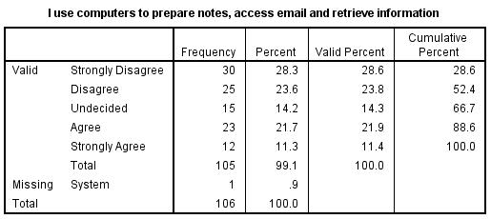
Frequency Table Example
Source: Thematic research on application of ICT in Ethiopian high schools, 2019

Slide 11
Example …
The above table can tell us meaningful information such as
What is status of computer utilization by teachers in Ethiopian high schools?
What is the percentage of teachers who use computers to prepare teaching materials?

Slide 12
Bivariate Analysis
Common bivariate data analysis method for non-metric data is cross-tabulation
Cross tabulation allows us to examine association of two variables
Simplest form of cross-tabulation is the two-by-two table

Slide 13
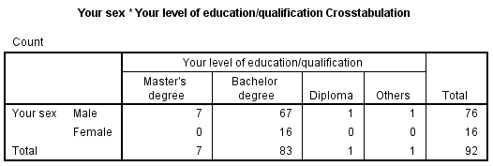
Constructing …
You can create a frequency table with two variables
This is called Bivariate frequency table
Source: Thematic research on application of ICT in Ethiopian high schools, 2019

Slide 14
UNIVARIATE ANALYSIS
Univariate analysis is all about studying the attributes or distribution of a single variable of interest
Measures of central tendency are the most important technique in univariate analysis, which provides information about the central location of a distribution.
The three most frequently used measures of central tendency are mode, median and mean

Slide 15
Mean
The arithmetic mean is the most commonly used and accepted measure of central tendency
it is used to assess the association between two variables.
Assume an organization (X) that uses web based sales and the other organization (Y) using the traditional sales method through physical sales shop
X average monthly sales is 10, 000 birr while Y monthly sales is 7, 000 birr
Mean is used to conclude which organization has a better sales performance
You can apply T-test to check its statistical significance

Slide 16
Measures of Dispersion/Variability
The measure of central tendency serve to locate the center of the distribution,
Do not measure how the items are spread out on either side of the center.
This characteristic of a frequency distribution is commonly referred to as dispersion.
Small dispersion indicates high uniformity of the items,
Large dispersion indicates less uniformity.
Uniformity is a desirable characteristic such as income or Internet access in Addis Ababa

Slide 17
Some measures of dispersion
Range - the difference between maximum and minimum values
E.g Distribution of IT staff among large organizations?
Quartiles (into four) – Median divides a data set into two equal halves while quartile divides an arranged data set equally into four groups
Q1, defines a position where 25 per cent of the values are smaller and 75 per cent are larger
Percentile – divides the distribution into 100 points
E.g. how much percent of people use Internet?

Slide 18
Dispersion …
The variance (s²) is another measure of variability.
Its formula is
Standard deviation (s) is most frequently used one
Used for interval/ratio measurements (continuous data)
It is the square root of variance
provides the average measurement of data from mean.

Slide 19
Interpretation of Variance
We expect about two-thirds of the scores in a sample to lie within one standard deviation of the mean.
Generally, most of the scores in a normal distribution cluster fairly close to the mean,
There are fewer and fewer scores as you move away from the mean in either direction.
In a normal distribution, 68.26% of the scores fall within one standard deviation of the mean,
95.44% fall within two standard deviations, and
99.73% fall within three standard deviations.

Slide 20
Bivariate (two variables) Analysis
Used to assess the relationship between two variables
Researchers can then assess whether a change in one variable results in change in the other variable to ascertain the relationship.
Therefore the association can be simple or causal relationship

Slide 21
Correlation
Correlation is one of the most widely used measures of association between two or more variables.
used to measure the linear association between variables
For example, assume X is IT skill and Y is IT use. Is there association b/n these two variables

Slide 22
Correlation …
Correlation expresses the inter-dependence of two sets of variables upon each other.
One variable may be called as independent variable (IV) and the other is dependent variable (DV)
A change in the IV has an influence in changing the value of dependent variable
For example IT use will increase organization productivity
Because IT provides many benefits to increase operational efficiency

Slide 23
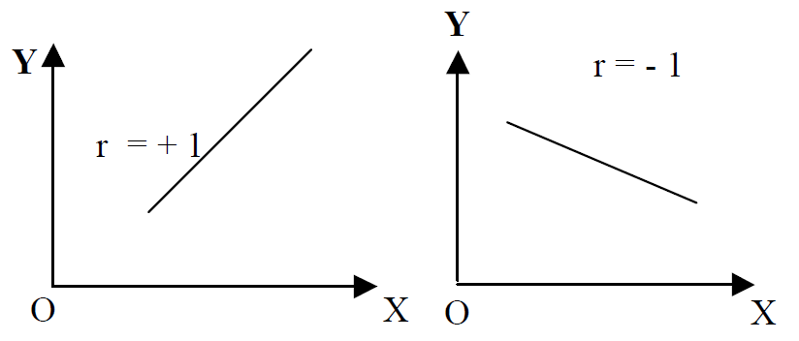
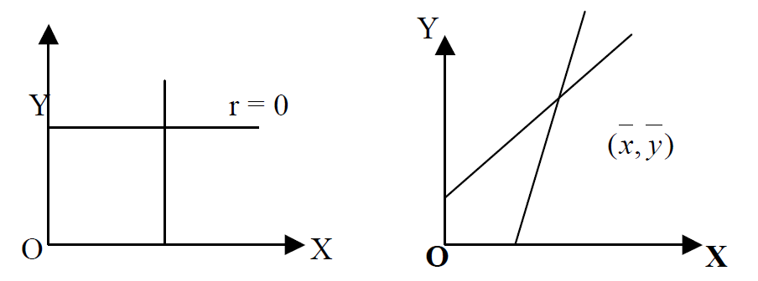
Correlation Lines
Perfect Correlation
No Correlation

Slide 24
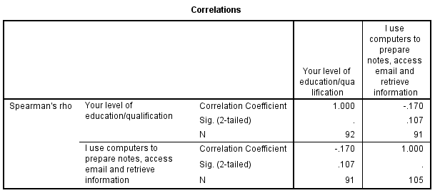
Example of Correlation

Slide 25
Parametric and Non Parametric Tests
There are many parametric test but some examples are
Pearson correlation coefficient
T-test
ANOVA
Linear regression
Logistic regression

Slide 26
T-test
T-test is used when you want to compare two means.
It is a parametric inferential statistics to make inferences from your sample population to the parent population
Basic assumptions are
Variables must be measured with interval or ratio scale
Sample distribution should be normal distribution

Slide 27
ANOVA
Analysis of variance (ANOVA) is one of the statistical tools developed by Professor R.A. Fisher
ANOVA is used to test the homogeneity of several population means.
For example, five different software systems were used by five business organizations to increase their profit
Which organizations performs well?
Can it be generalizable for other unobserved organizations –
ANOVA is used for such purpose

Slide 28
Regression
Regression is used to estimate (predict) the value of one variable given the value of another.
The variable predicted on the basis of other variables is called the “dependent” or the ‘ explained’ variable and the other the ‘ independent’ or the ‘ predicting’ variable.
The prediction is based on average relationship derived statistically by regression analysis.
What are the predictor variables for IT project success
Top management support, team collaboration, project skills, etc may be considered as predictor variables

Slide 29
Regression
Regression is the measure of the average relationship between two or more variables in terms of the original units of the data.
Type of regression
Simple and Multiple
Linear and Non –Linear
Total and Partial

Slide 30
Simple and Multiple:
In case of simple relationship only two variables are considered,
for example, the influence user interface on software adoption
In the case of multiple regression, more than two variables are involved as predictor variables.

Slide 31
Linear and Non-linear
The linear relationships are based on straight-line trend, the equation of which has no-power higher than one.
In the case of non-linear relationship curved trend lines are derived.
The equations of these are parabolic.

Slide 32
Linear and Non linear relationship
Y
Y
X
X

Slide 33
Regression analysis
The goal of regression analysis is to develop a regression equation from which we can predict one score on the basis of one or more other scores.
For example, it can be used to predict a job applicant's potential job performance on the basis of test scores and other factors

Slide 34
Linear regression equation
Linear regression equation of Y on X is
Y = a + bX ……. (1)
And X on Y is
X = a + bY……. (2)
Where a, b are constants.
In a regression equation, y is the dependent variable or criterion variable, or outcome variable we would like to predict.
X represents the variable we are using to predict y; x is called the predictor variable.

Slide 35
Linear
a is called the regression constant (or beta-zero), and is the y-intercept of the line that best fits the data in the scatter plot;
It is the value when the independent variable (X) is zero
B is the slope of the line that best represents the relationship between the predictor variable (x) and the criterion variable (y).
You can use multiple regression
Y= a+bx₁+bx₂+….+bx_{n}

Slide 36
Making Generalization - Statistical significance
We use statistical significance to accept or reject hypothesis
For example
Alternative (Experimental) hypothesis
(e.g. ERP use increases organization efficiency ).
Null hypothesis, which asserts that there is no difference between conditions (e.g. ERP use has no effect on organization efficiency, any observed difference is by chance factor.

Slide 37
ERP use
Organizational efficiency
H1: ERP use increases organization efficiency

Slide 38
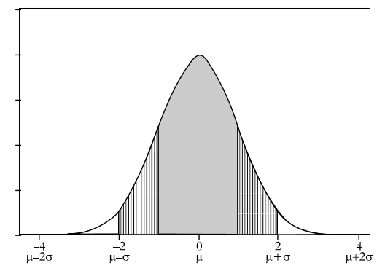
Characteristics of standard normal distribution
68%
95%

Slide 39
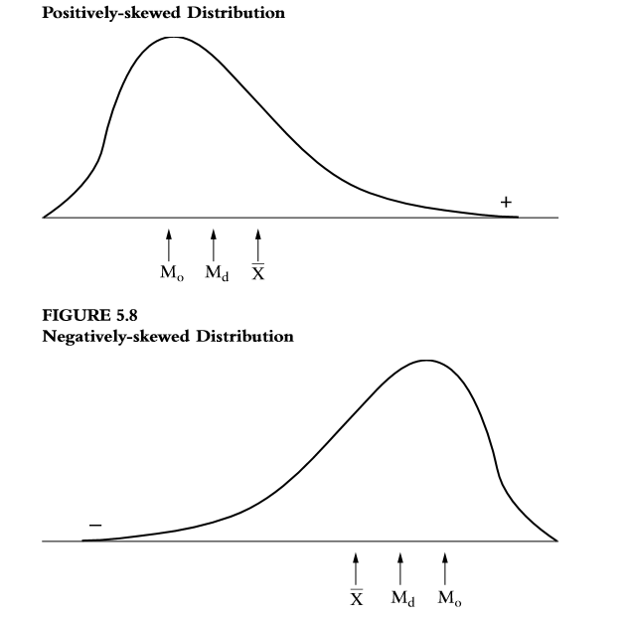

Slide 40
Statistical ….
Psychologists generally use the 5% (0.05) level of statistical significance. What this means is that the null hypothesis is rejected (and the experimental hypothesis is accepted) if the probability that the results were due to chance alone is 5% or less.
This is often expressed as p = 0.05
You can use other values such as 10%, or 1%
A different values other than 5% may lead to Type I and Type II errors

Slide 41

Other Technique Confidence interval Method
When you compute a confidence interval on the mean, you compute the mean of a sample in order to estimate the mean of the population.
Assume that the weights of 10-year-old children are normally distributed with a mean of 40kg and a standard deviation of 12.
What is the sampling distribution (you take as many samples as you can and plot its result) of the mean for a sample size of 36?
The formula (standard error ) is given by
The sampling distribution of the mean has a mean of 40 and a standard deviation of 12/6 = 2.
Therefore the population mean cannot be outside 38kg to 42Kg.

Slide 42
Final Notes
What are the factors that influence people’s acceptance of new technology?
The answer to this question is important for technology designers
We get ideas from Technology Acceptance Theory
Usefulness
Technology Acceptance
Intention
Ease of use
Source – Davis, 1999?

Slide 43
Research Model
Increased productivity
Intention to use tax collection system
tax collection system acceptance
Increased quality of output
Usefulness
Technology Acceptance
Intention
Ease of use
Reduce personal effort
Easy information access

Slide 44
Research Model
Increased productivity
Increased quality of output
Intention to use tax collection system
tax collection system acceptance
Reduce personal effort
Easy information access

Slide 45
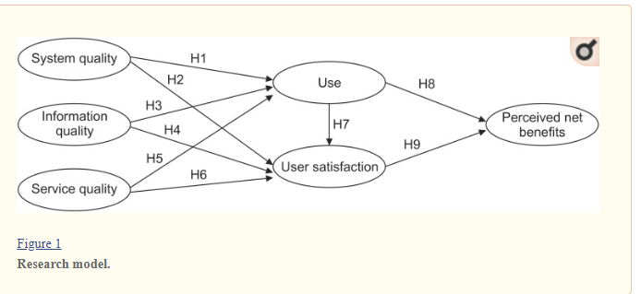
DeLone and McLean Information Systems Success Model

Slide 46
Hypothesis …
Example
H₁
System quality influences user satisfaction for perceived benefits of IT
Ho
System quality does influences user satisfaction for perceived benefits of IT. Any observed influence is by chance factor

Slide 47
Develop Instrument
Based the variables in your research model, develop data collection instrument to collect empirical data
Your data collection instrument for quantitative research is normally questionnaire
One variable can be measured by two or more question items

Slide 48
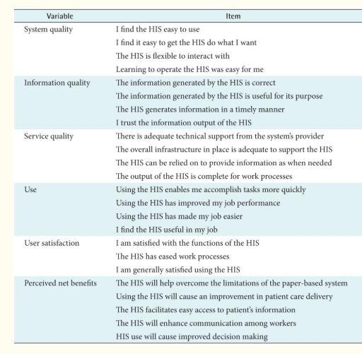

Slide 49
Data analysis
Data analysis is conversion of raw data collected through your questionnaire into meaningful information
Analysis tools can be as simple as mean and standard deviation and
as complex as linear and logistic regression
During data analysis, you accept or reject your hypothesis
Hypothesis testing is a base for your research conclusion

Slide 50
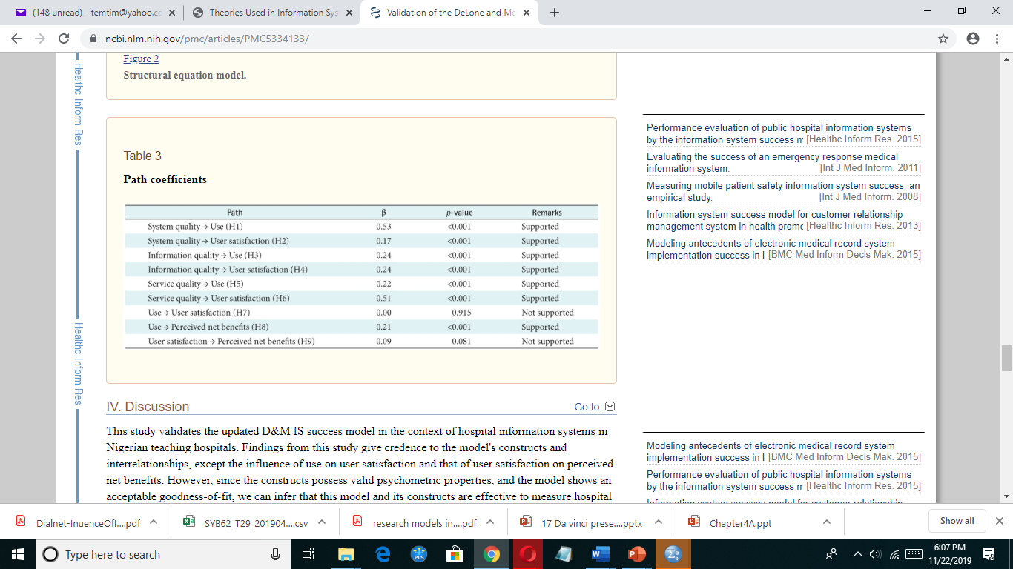

Slide 51
Assignment
Read a journal research article which is done with quantitative research method.
Write the type data analysis method used by the researcher?

Slide 52
Review Questions
What is data analysis?
What are the different data analysis methods?
How do you measures your research variables?
What is hypothesis?
What is statistical significance?
What is the difference between parametric and non parametric tests?
How do you accept or reject hypothesis?
Explain type I and type II errors in hypothesis testing

Slide 53
References
http://onlinestatbook.com/2/normal_distribution/normal_distribution.html

